Slide 1
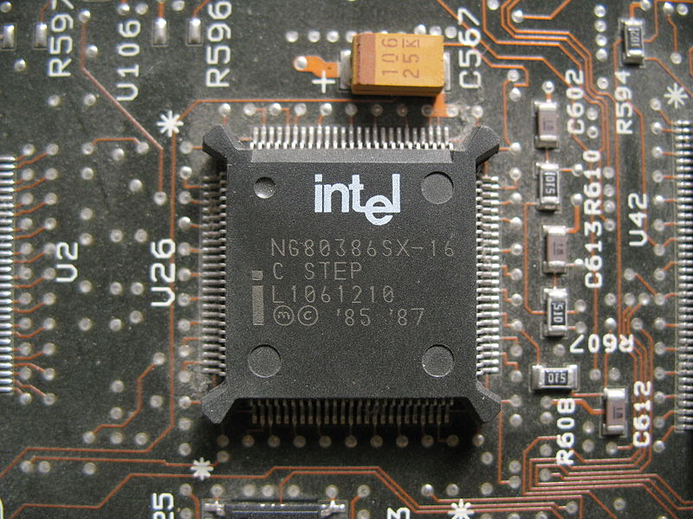
80386 Microprocessor

Slide 2
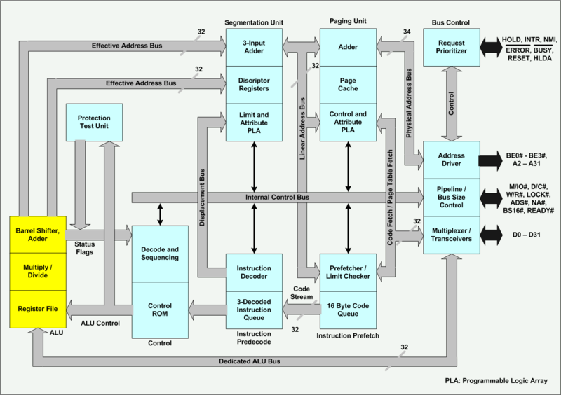
Architecture of 80386

Slide 3
Architecture of 80386
The Internal Architecture of 80386 is
divided into 3 sections:
• Central processing unit
• Memory management unit
• Bus interface unit

Slide 4
Architecture of 80386
Central processing unit is further divided into
- Execution unit
- Instruction unit
• Execution unit has 8 General purpose and 8
Special purpose registers which are either
used for handling data or calculating offset
addresses.

Slide 5
Architecture of 80386
The Instruction unit decodes the opcode bytes received from the 16-byte instruction code queue and arranges them in a 3- instruction decoded instruction queue.
After decoding them pass it to the control section for deriving the necessary control signals.
The barrel shifter increases the speed of all
shift and rotate operations.

Slide 6
Architecture of 80386
The multiply / divide logic implements the bit-shift-rotate algorithms to complete the operations in minimum time.
Even 32- bit multiplications can be executed within one microsecond by the multiply / divide logic.

Slide 7
Architecture of 80386
The Memory management unit consists of a Segmentation unit and a Paging unit.
Segmentation unit allows the use of two address components, viz. segment and offset for relocability and sharing of code and data.
Segmentation unit allows segments of size 4Gbytes at max.

Slide 8
Architecture of 80386
The Paging unit organizes the physical memory in terms of pages of 4kbytes size each.
Paging unit works under the control of the segmentation unit, i.e. each segment is further divided into pages.
The virtual memory is also organized in terms of segments and pages by the memory management unit.

Slide 9
Architecture of 80386
The Segmentation unit provides a 4 level protection mechanism for protecting and isolating the system code and data from those of the application program.
Paging unit converts linear addresses into physical addresses.

Slide 10
Architecture of 80386
The control and attribute PLA checks the privileges at the page level.
Each of the pages maintains the paging information of the task.
The limit and attribute PLA checks segment limits and attributes at segment level to avoid invalid accesses to code and data in the memory segments.

Slide 11
Architecture of 80386
The Bus control unit has a prioritizer to resolve the priority of the various bus requests.
This controls the access of the bus. The address driver drives the bus enable and address signal A0 – A31.
The pipeline and dynamic bus sizing unit handles the related control signals.
The data buffers interface the internal data bus with the system bus.

Slide 12
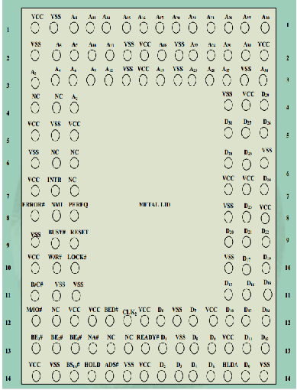
Pin Configuration of 80386

Slide 13
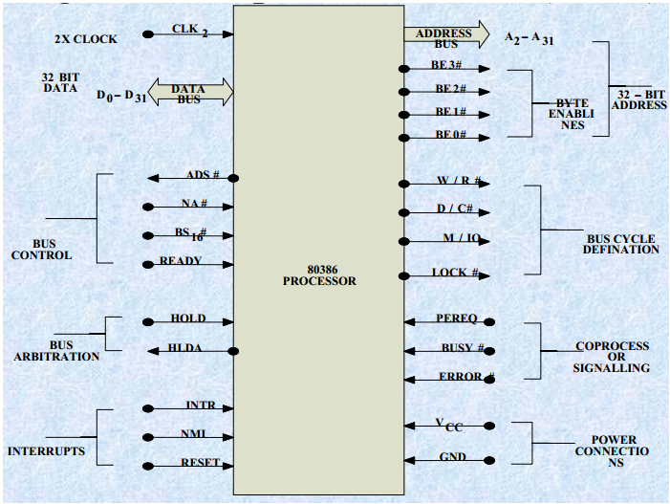
Signal Diagram of 80386

Slide 14
Signal Descriptions of 80386
CLK2 :The input pin provides the basic system clock timing
for the operation of 80386.
D0 – D31:These 32 lines act as bidirectional data bus during
different access cycles.
A31 – A2: These are upper 30 bit of the 32- bit address bus.
BE0 to BE3: The 32- bit data bus supported by 80386 and the
memory system of 80386 can be viewed as a 4- byte wide
memory access mechanism. The 4 byte enable lines BE0
to BE3, may be used for enabling these 4 blanks. Using
these 4 enable signal lines, the CPU may transfer 1 byte /
2 / 3 / 4 byte of data simultaneously.

Slide 15
Signal Descriptions of 80386
W/R#: The write / read output distinguishes the write and read
cycles from one another.
D/C#: This data / control output pin distinguishes between a
data transfer cycle from a machine control cycle like
interrupt acknowledge.
M/IO#: This output pin differentiates between the memory
and I/O cycles.
LOCK#: The LOCK# output pin enables the CPU to prevent
the other bus masters from gaining the control of the system bus.
NA#: The next address input pin, if activated, allows address
pipelining, during 80386 bus cycles.

Slide 16
Signal Descriptions of 80386
ADS#: The address status output pin indicates that the address bus and bus cycle definition pins (W/R#, D/C#, M/IO#, BE0# to BE3# ) are carrying the respective valid signals.
The 80386 does not have any ALE signals and so this signals may be used for latching the address to external latches.
READY#: The ready signals indicates to the CPU that the previous bus cycle has been terminated and the bus is ready for the next cycle. The signal is used to insert WAIT states in a bus cycle and is useful for interfacing of slow devices with CPU.
VCC: These are system power supply lines.
VSS: These return lines for the power supply.

Slide 17
Signal Descriptions of 80386
BS16#: The bus size – 16 input pin allows the interfacing of 16
bit devices with the 32 bit wide 80386 data bus. Successive 16 bit bus cycles may be executed to read a 32 bit data from a peripheral.
HOLD: The bus hold input pin enables the other bus masters to gain control of the system bus if it is asserted.
HLDA: The bus hold acknowledge output indicates that a
valid bus hold request has been received and the bus has been relinquished by the CPU.
BUSY#: The busy input signal indicates to the CPU that the
coprocessor is busy with the allocated task.

Slide 18
Signal Descriptions of 80386
ERROR#: The error input pin indicates to the CPU that the coprocessor has encountered an error while executing its instruction.
PEREQ: The processor extension request output signal indicates to the CPU to fetch a data word for the coprocessor.
INTR: This interrupt pin is a maskable interrupt, that can be masked using the IF of the flag register.
NMI: A valid request signal at the non-maskable interrupt request input pin internally generates a non- maskable interrupt of type2.

Slide 19
Signal Descriptions of 80386
RESET: A high at this input pin suspends the current operation and restart the execution from the starting location.
N / C : No connection pins are expected to be left open while connecting the 80386 in the circuit.

Slide 20
Register Organisation
The 80386 has eight 32 - bit general purpose registers which
may be used as either 8 bit or 16 bit registers.
A 32 - bit register known as an extended register, is represented by the register name with prefix E.
Example : A 32 bit register corresponding to AX is EAX,
similarly BX is EBX etc.
The 16 bit registers BP, SP, SI and DI in 8086 are now available with their extended size of 32 bit and are names as EBP,ESP,ESI and EDI.
AX represents the lower 16 bit of the 32 bit register EAX.
BP, SP, SI, DI represents the lower 16 bit of their 32 bit
counterparts, and can be used as independent 16 bit registers.

Slide 21
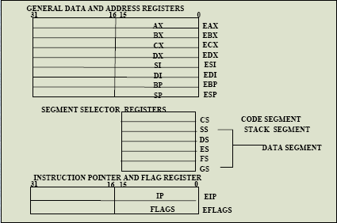
Register Organisation (cont..)

Slide 22
Register Organisation (cont..)
The six segment registers available in 80386 are CS, SS, DS,
ES, FS and GS.
The CS and SS are the code and the stack segment registers
respectively, while DS, ES, FS, GS are 4 data segment registers.
A 16 bit instruction pointer IP is available along with 32 bit counterpart EIP.
Flag Register of 80386: The Flag register of 80386 is a 32 bit
register. Out of the 32 bits, Intel has reserved bits D18 to D31,
D5 and D3, while D1 is always set at 1.
Two extra new flags are added to the 80286 flag to derive the flag register of 80386. They are VM and RF flags.

Slide 23

Register Organisation (cont..)

Slide 24
Register Organisation (cont..)
VM - Virtual Mode Flag: If this flag is set, the 80386 enters
the virtual 8086 mode within the protection mode. This is to be set only when the 80386 is in protected mode. In this mode, if any privileged instruction is executed an exception 13 is generated.
This bit can be set using IRET instruction or any task switch operation only in the protected mode.
RF- Resume Flag: This flag is used with the debug register
breakpoints. It is checked at the starting of every instruction cycle and if it is set, any debug fault is ignored during the instruction cycle.
The RF is automatically reset after successful execution of every instruction, except for IRET and POPF instructions.

Slide 25
Register Organisation (cont..)
Also, it is not automatically cleared after the successful execution of JMP, CALL and INT instruction causing a task switch. These instructions are used to set the RF to the value specified by the memory data available at the stack.
Segment Descriptor Registers: This registers are not available for programmers, rather they are internally used to store the descriptor information, like attributes, limit and base addresses of segments.
The six segment registers have corresponding six 73 bit descriptor registers. Each of them contains 32 bit base address, 32 bit base limit and 9 bit attributes. These are automatically loaded when the corresponding segments are loaded with selectors.

Slide 26
Register Organisation (cont..)
Control Registers: The 80386 has three 32 bit control registers :CR1, CR2 and CR3 to hold global machine status independent of the executed task. Load and store instructions are available to access these registers.
System Address Registers: Four special registers are defined to refer to the descriptor tables supported by 80386.
The 80386 supports four types of descriptor table, viz. global descriptor table (GDT), interrupt descriptor table (IDT), local descriptor table (LDT) and task state segment descriptor (TSS).

Slide 27
Register Organisation (cont..)
Debug and Test Registers: Intel has provide a set of 8 debug registers for hardware debugging. Out of these eight registers DR0 to DR7, two registers DR4 and DR5 are Intel reserved.
The initial four registers DR0 to DR3 store four program controllable breakpoint addresses, while DR6 and DR7 respectively hold breakpoint status and breakpoint control information.
Two more test registers are provided by 80386 for page cacheing namely test control and test status register.

Slide 28
Memory Organization and Segmentation
The physical memory of an 80386 system is organized as a sequence of 8-bit bytes. Each byte is assigned a unique address that ranges from zero to a maximum of 232-1 (4 gigabytes).
80386 programs, however, are independent of the physical address space.
This means that programs can be written without knowledge of how much physical memory is available and without knowledge of exactly where in physical memory the instructions and data are located.

Slide 29
Memory Organization and Segmentation
The model of memory organization seen by applications programmers is determined by systems-software designers.
The architecture of the 80386 gives designers the freedom to choose a model for each task.

Slide 30
Memory Organization and Segmentation
The model of memory organization can range between the following extremes:
A "flat" address space consisting of a single array of up to 4 gigabytes.
A segmented address space consisting of a collection of up to 16,383 linear address spaces of up to 4 gigabytes each.
Both models can provide memory protection.

Slide 31
The Flat Model
In a "flat" model of memory organization, the applications programmer sees a single array of up to 232 bytes (4 gigabytes).
While the physical memory can contain up to 4 gigabytes, it is usually much smaller
The processor maps the 4 gigabyte flat space onto the physical address space by the address translation mechanisms.
Applications programmers do not need to know the details of the mapping.

Slide 32
The Flat Model (contn.)
A pointer into this flat address space is a 32-bit ordinal number that may range from 0 to 232-1.
Relocation of separately-compiled modules in this space must be performed by systems software (e.g., linkers, locators, binders, loaders).

Slide 33
The Segmented Model
In a segmented model of memory organization, the address space as viewed by an applications program (called the logical address space) is a much larger space of up to 246 bytes (64 terabytes).
The processor maps the 64 terabyte logical address space onto the physical address space (up to 4 gigabytes) by the address translation mechanisms.
Applications programmers do not need to know the details of this mapping.

Slide 34
The Segmented Model (contn.)
Applications programmers view the logical address space of the 80386 as a collection of up to 16,383 one-dimensional subspaces, each with a specified length.
Each of these linear subspaces is called a segment. A segment is a unit of contiguous address space. Segment sizes may range from one byte up to a maximum of 232 bytes (4 gigabytes).

Slide 35
The Segmented Model (contn.)
A complete pointer in this address space consists of two parts: (Fig. Two Component Pointer)
1. A segment selector, which is a 16-bit field that identifies a segment.
2. An offset, which is a 32-bit ordinal that addresses to the byte level within a segment.

Slide 36
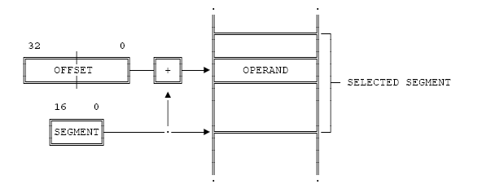
Two Component Pointer

Slide 37
The Segmented Model (contn.)
During execution of a program, the processor associates with a segment selector the physical address of the beginning of the segment.
Separately compiled modules can be relocated at run time by changing the base address of their segments. The size of a segment is variable; therefore, a segment can be exactly the size of the module it contains.

Slide 38
Features of 80386
The memory management section of 80386 supports the virtual memory, paging and four levels of protection, maintaining full compatibility with 80286.
The 80386 offers a set of 8 debug registers DR0-DR7 for hardware debugging and control.
The 80386 has on-chip address translation cache.

Slide 39
Features of 80386
The concept of paging is introduced in 80386 that enables it to organise the available physical memory in terms of pages of size 4Kbytes each, under the segmented memory.
The 80386 can be supported by 80387 for mathematical data processing.

